Slide 1
Subject Presentation Video: Photography
Supporting you to make an informed decision
If you have any questions, please contact me on:

Slide 2
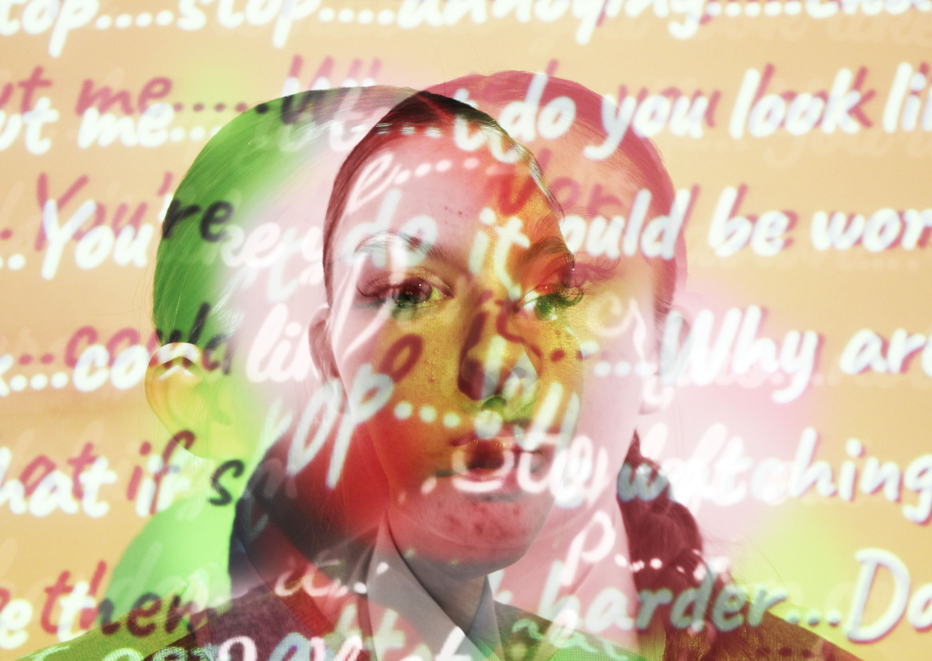
GCSE Photography
60% Component 1
This is all work from Year 10 until Jan Year 11
One project and a selection of further work
You will get to develop your own project from a series of themes and choose your own artist.
40% Externally Set Task
From Jan Year 11 until Easter
A smaller project with themes set by the exam board.
Photography is the practice of producing images using light-sensitive materials such as photographic film, or digital methods of development and production to create static or moving images.
Is there an exam?
There is a 10 hour exam where you create the final piece including editing and presentation. It is not a written test.
Notes:
You will learn how to use a wide range of photographic techniques and have access to DSLRs to create high quality images. You will have personal choice in the development of your work. You will have the opportunity to engage with a variety of modern and historical photographers with a trips to locations, Art galleries and to Photography studios.

Slide 3
2024
Grades 9-7= 17% NA: 19.1%
Grades 9-4 = 83.3% NA: 78.3%
2023
Grades 9-7= 18% NA: 20%
Grades 9-4= 82% NA: 78%
2022 –NO EXAM PROJECT
Grades 9-7= 33% NA: 28.2%
Grades 9-4= 83% NA: 82%
2021 - TAGS
Grades 9-7= 18.5% NA: 29.6%
Grades 9-4= 70% NA: 87%
2020 - CAGS
Grades 9-7 =19% NA: 29.6%
Grades 9-4 = 70% NA: 87%
2019
Grades 9-7 = 0% NA: 23%
Grades 9-4 = 71% NA: 75%
Photography
GCSE results

Slide 4
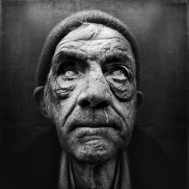
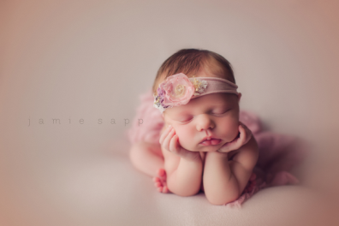
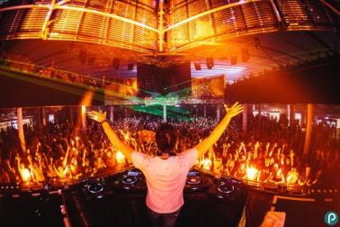
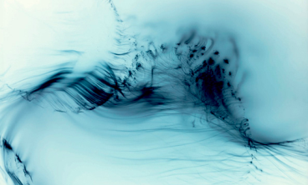
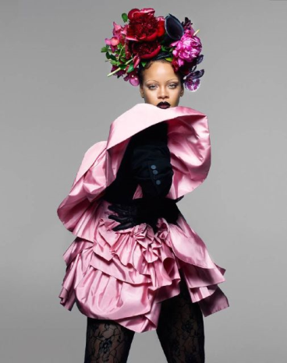
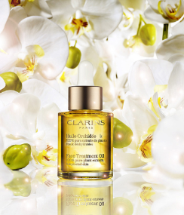
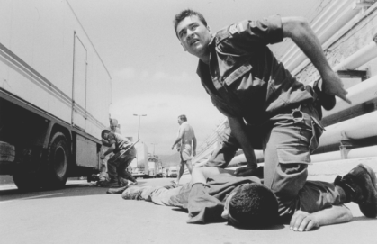
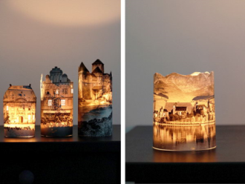
Portrait
photographer
Newborn/family
photographer
Wedding/events
photographer
Taking images could
be your primary
focus, or you may
work with
photographic images
to produce related
products such as film,
advertising, web
content. You may work
freelance or work for
a specific company.
Fine art photographer
Photography
Career Options
Fashion photographer
Documentary
photographer
Commercial
photographer
Artist/craftsperson

Slide 5
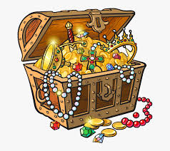
What will you get out of choosing Photography?
Practical life skill – photography has many applications in wide range of careers
Increased technical skills
Self expression opportunities – increased self awareness and confidence
Deeper understanding of Photography and Art
Teamwork and collaboration skills
Proactive work ethic
Risk taking and courage
Comedy moments (many)

Slide 6
What will I be doing in Photography?
Do I have to do writing?
YES!
Analysis of artists
Analysis of your work/ideas
Description of creative process
30%
Taking photos
30%
Editing
30% Presenting and analysis

Slide 7
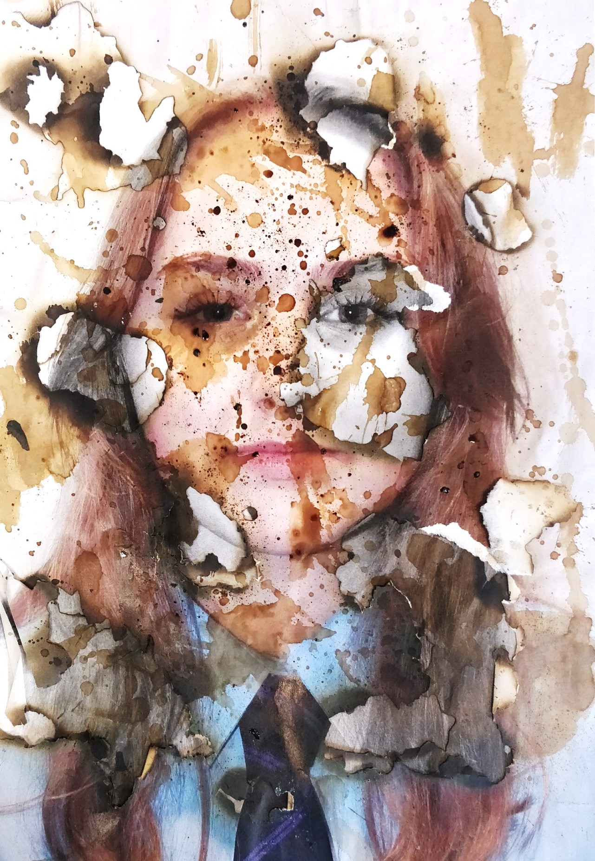
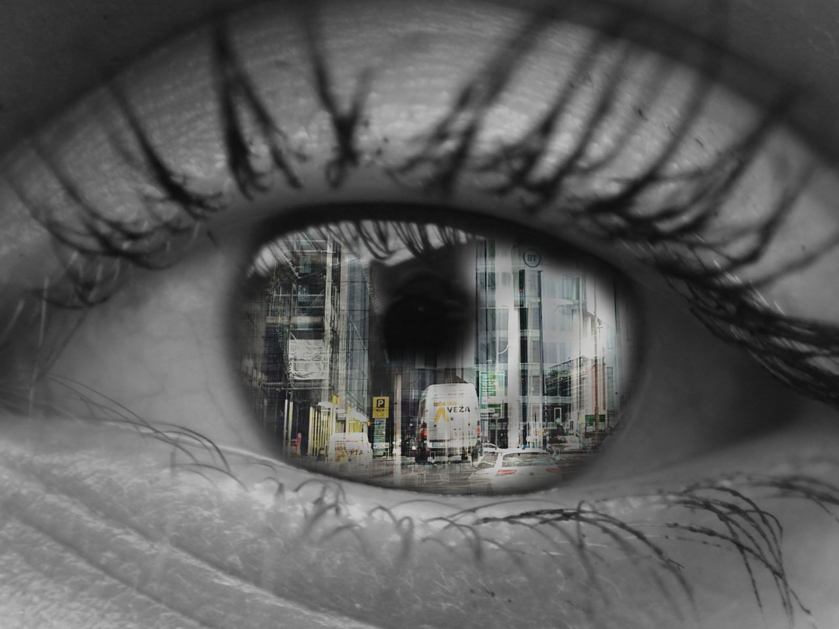
Can I use my Art skills in Photography?
Physical edit
Digital edit

Slide 8
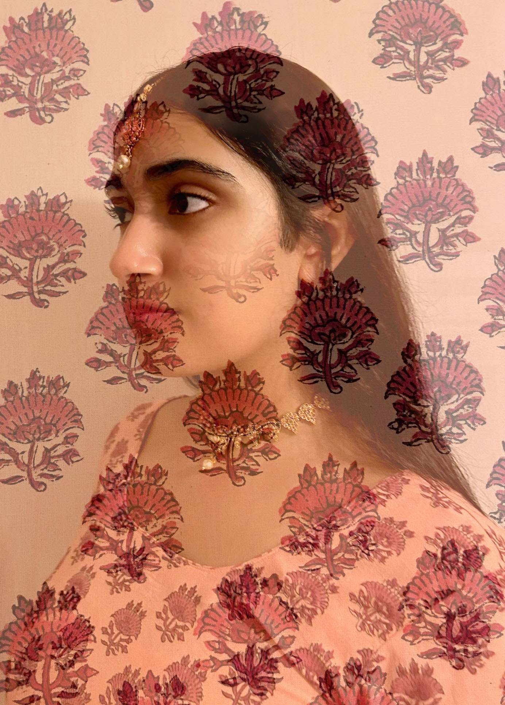
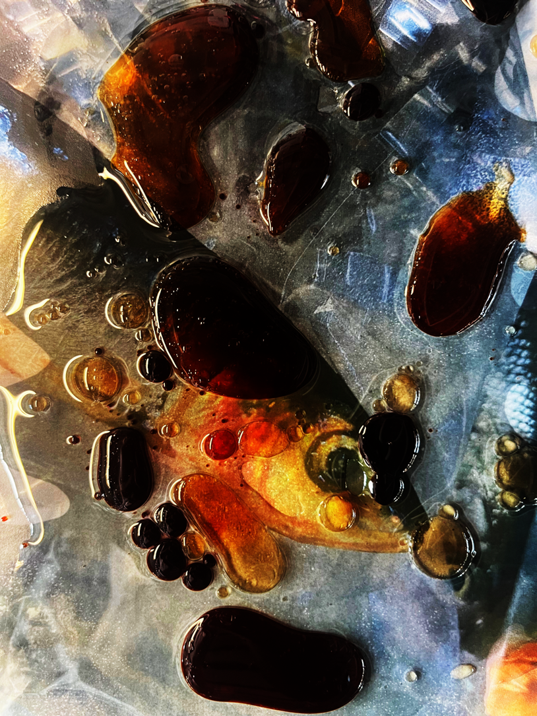
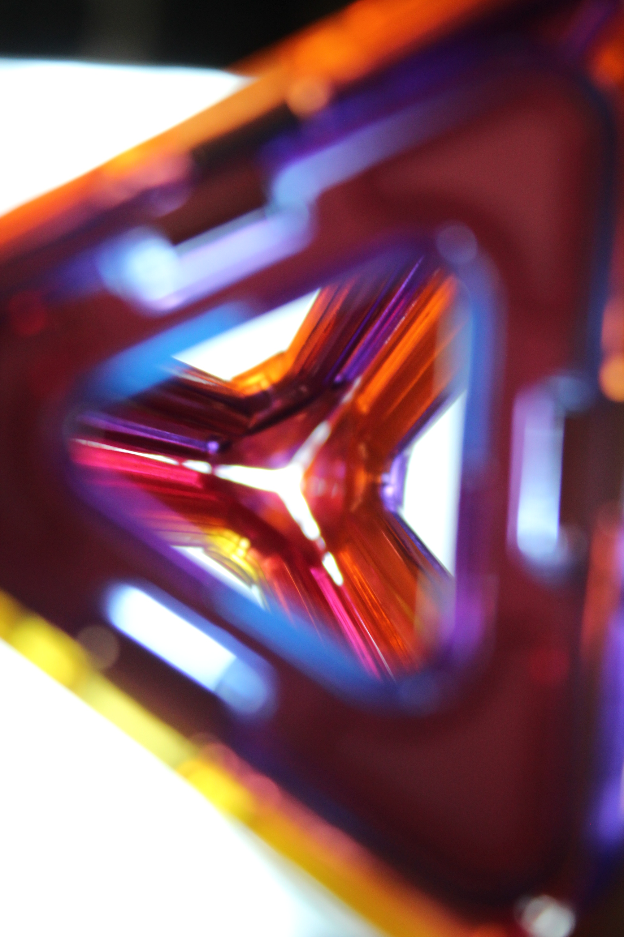
What projects or themes will we get to do?
Year 10 Photography:
Further work:
Key concepts/Visual Elements– building skills with DSLR cameras and equipment
Year 10-11
Sustained project: Portraiture
Students can personalise their work within this broader theme
Year 11:
Externally Set Unit:
Student choice from 7 themes set by the exam board

Slide 9
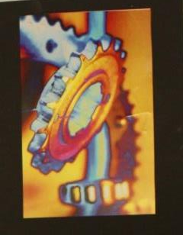
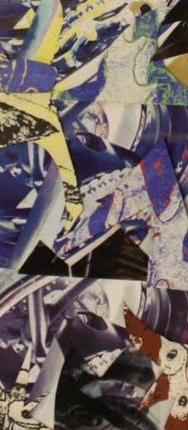
Is there loads of homework?
If Art and Photography are available in separate option blocks then yes, you can select both as options.
Please be aware:
Deadlines for both subjects are the same
Both subjects are coursework heavy and therefore require consistent effort over the whole of the course
Both require commitment to work at home and after school
Exams are likely to take place very closely together – possibly in one week
You can create photography outcomes in the Fine Art course and you can explore practical manipulation in the Photography course.
Can I do Art AND Photography?

Slide 10
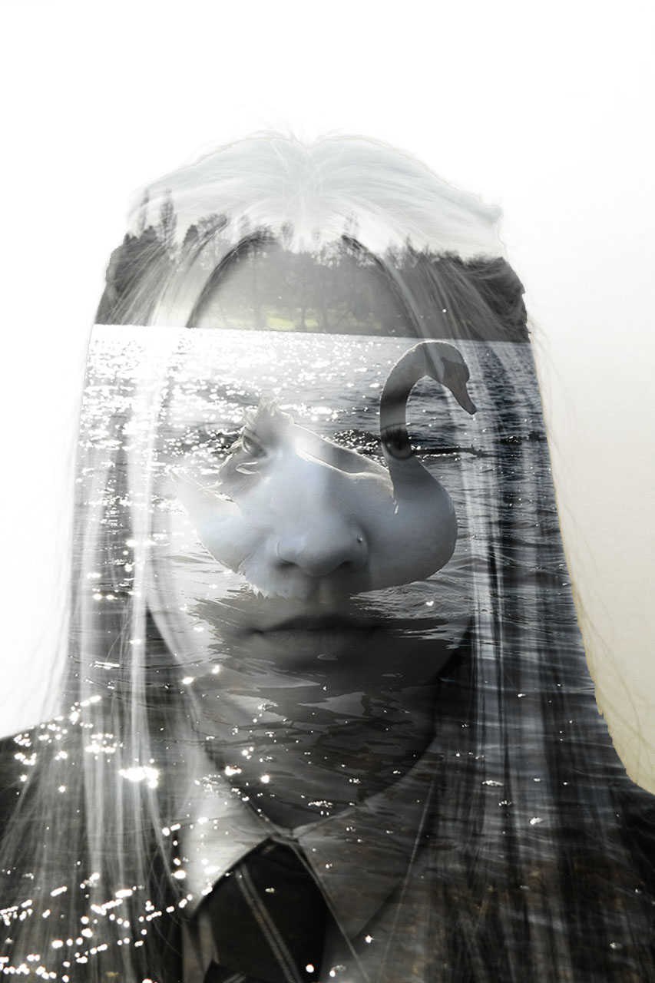
What skills do I need to do a Photography GCSE?
You need to be trustworthy and mature with
equipment and resources
Be willing to be a model in other people’s photos
Willing to take risks and be out of your comfort zone
Willing to go out to locations over the weekend
Good level of technological ability – can you use
Outlook, OneDrive, Photoshop, Powerpoint?
Decent written ability – can you analyse?
Project management skills/organisation
Commitment to meet deadlines – cwk subject!
Can generate ideas/creative thinking/independence

